Slide 1


Presentation On ERP Product for ait as saas and backend design
Team Id: 64750
Prepared By:
130020107026-Darshit S Jasani
130020107065-Miloni S Patel
130020107086-Harshrajsinh V Rathod
Guided By : Prof. Dr. Satyadev Vyas

Slide 2
Presentation Contents
Introduction
Problem statement
Objectives
Related Background
Tools & Technology
System Flow(Diagrams)
Modules in Project
Features
Snapshots of GUI
Expected outcome
Advantages
Limitations
Future work
References

Slide 3
INTRODUCTION
The basic idea is to create a Website as SaaS which provides all the latest features which are unavailable in the existing one and easy access to the Students, Guardians, Admins and Faculties, so they can easily interact with Eachother.
The SaaS concept is aimed for various browsers which will break the limit of platform on which we are using this website and will be useful medium between faculty, HODs, administrative staff, Guardians and the students as well.

Slide 4
PROBLEM STATEMENT
Sometimes attendance taken in paper might be misplaced.
Sometimes the assignments given by the faculties were unable to reach all the students or some urgent E-Books at exam time were time consuming to send it via Emails for faculties and for students to view as well.
Parents from distant areas cannot monitor their child’s academic progress as it is difficult to keep watch all the time personally.
To view midsem result and overall attendance student have to visit notic board

Slide 5
OBJECTIVES
Quicker availability of any kind of Information
related to College via easy navigation.
Better communication between all the four desired modules.
Easy to upload and download assignments and other materials related to coursework.
Awareness of college events to guardians also.

Slide 6
RELATED BACKGROUND
The current college website is not responsive and hence there is difficulty in viewing the same on mobile.
There are some features which aren’t available right now and we are trying to serve it in upcoming one like online assignment uploadation.
Therefore, the basic idea is to reduce the problems created while surfing the website and minimize the amount of effort and time the user has to put in to get the information.

Slide 7



TOOLS & TECHNOLOGY
Sublime Text 3
GNU Image Manipulation Program
WampServer

Slide 8
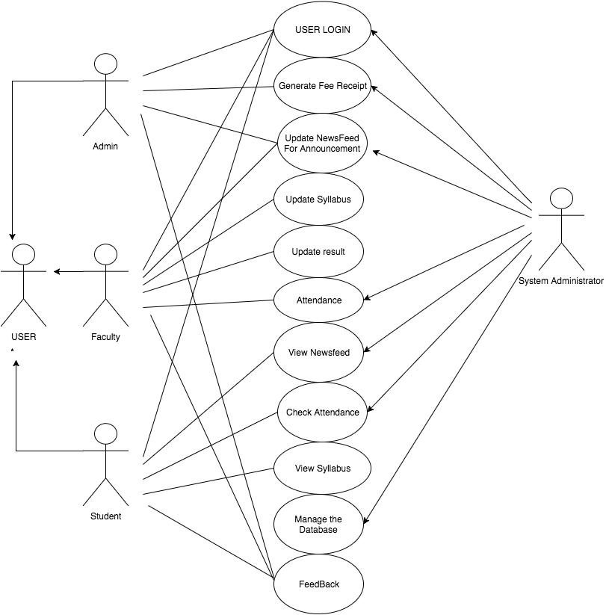
SYSTEM FLOWS
Use Case
Diagram

Slide 9
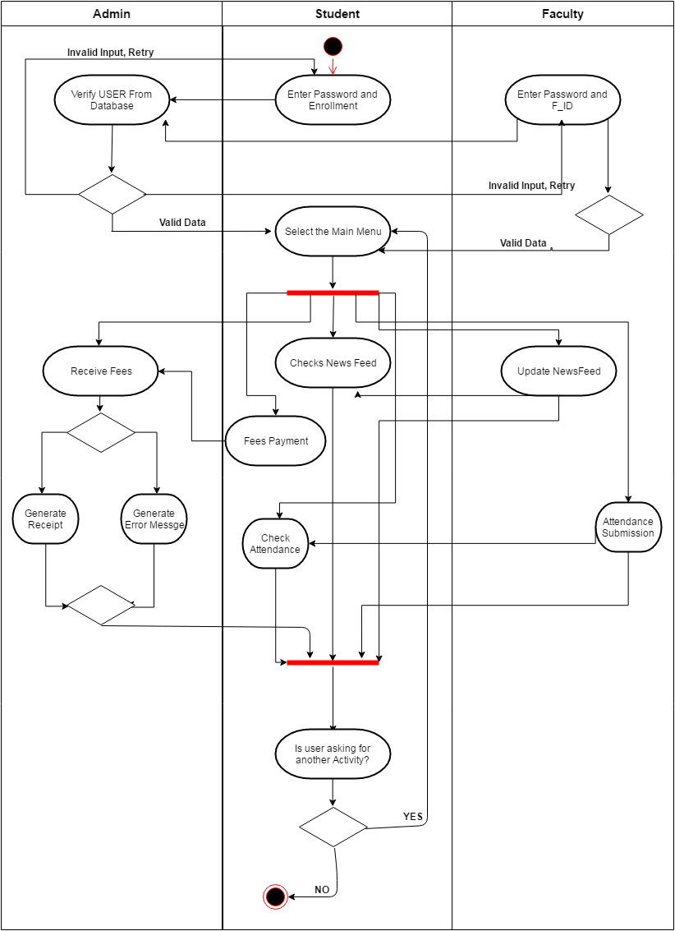
Activity
Diagram

Slide 10
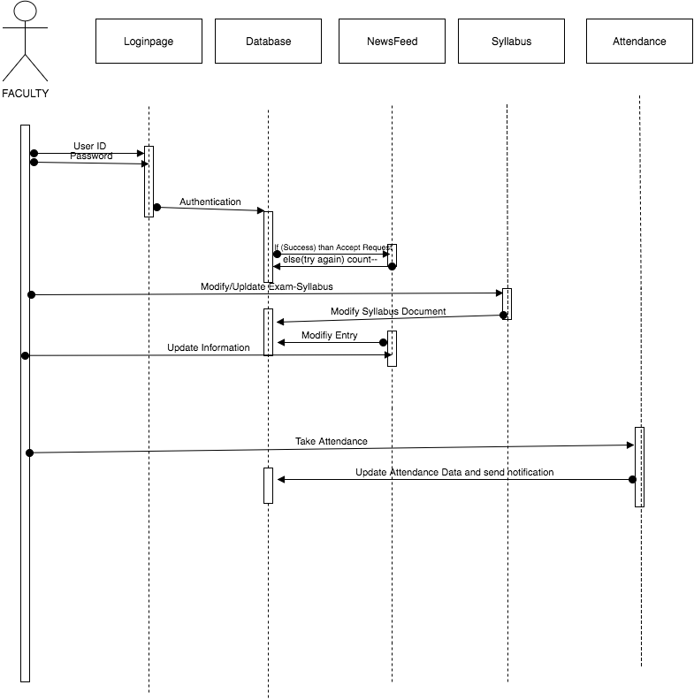
Sequence
Diagram

Slide 11
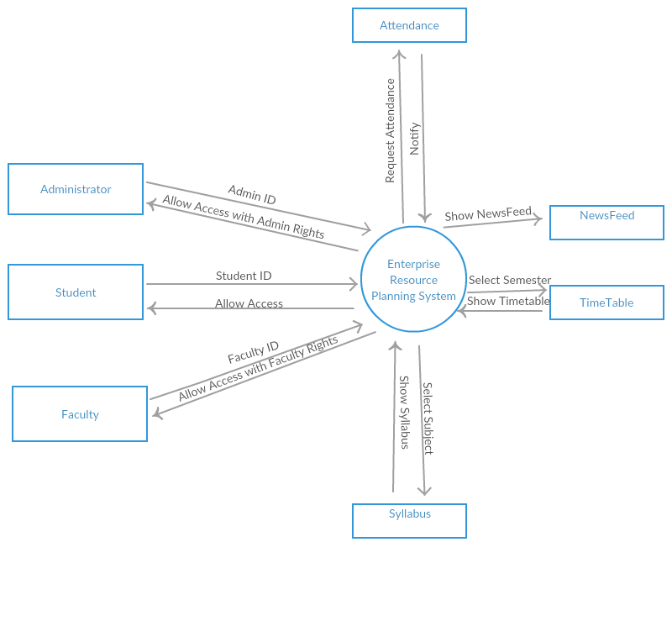
Context
Diagram

Slide 12
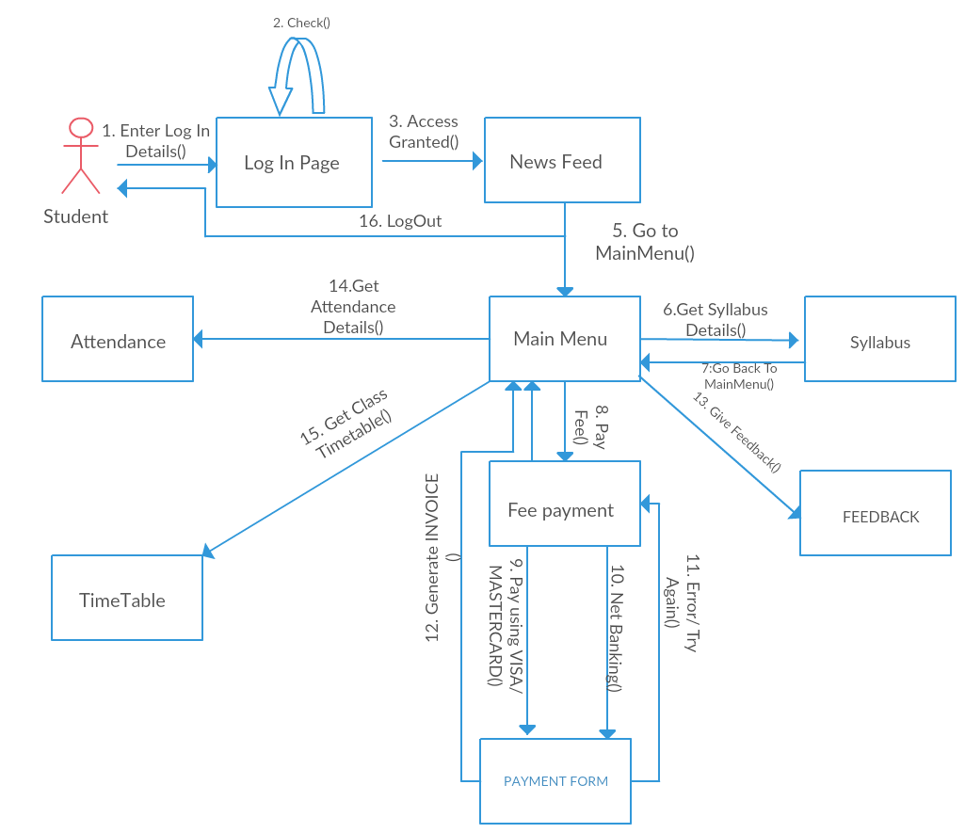
Collaboration
Diagram

Slide 13
MODULES IN PROJECT
Student
Admin
Parents/Guardians
Faculties
System Administrator

Slide 14
FEATURES
Timeline
User friendly
Easy Upload/Download materials related to college.
Uncluttered GUI.
Well arranged database

Slide 15
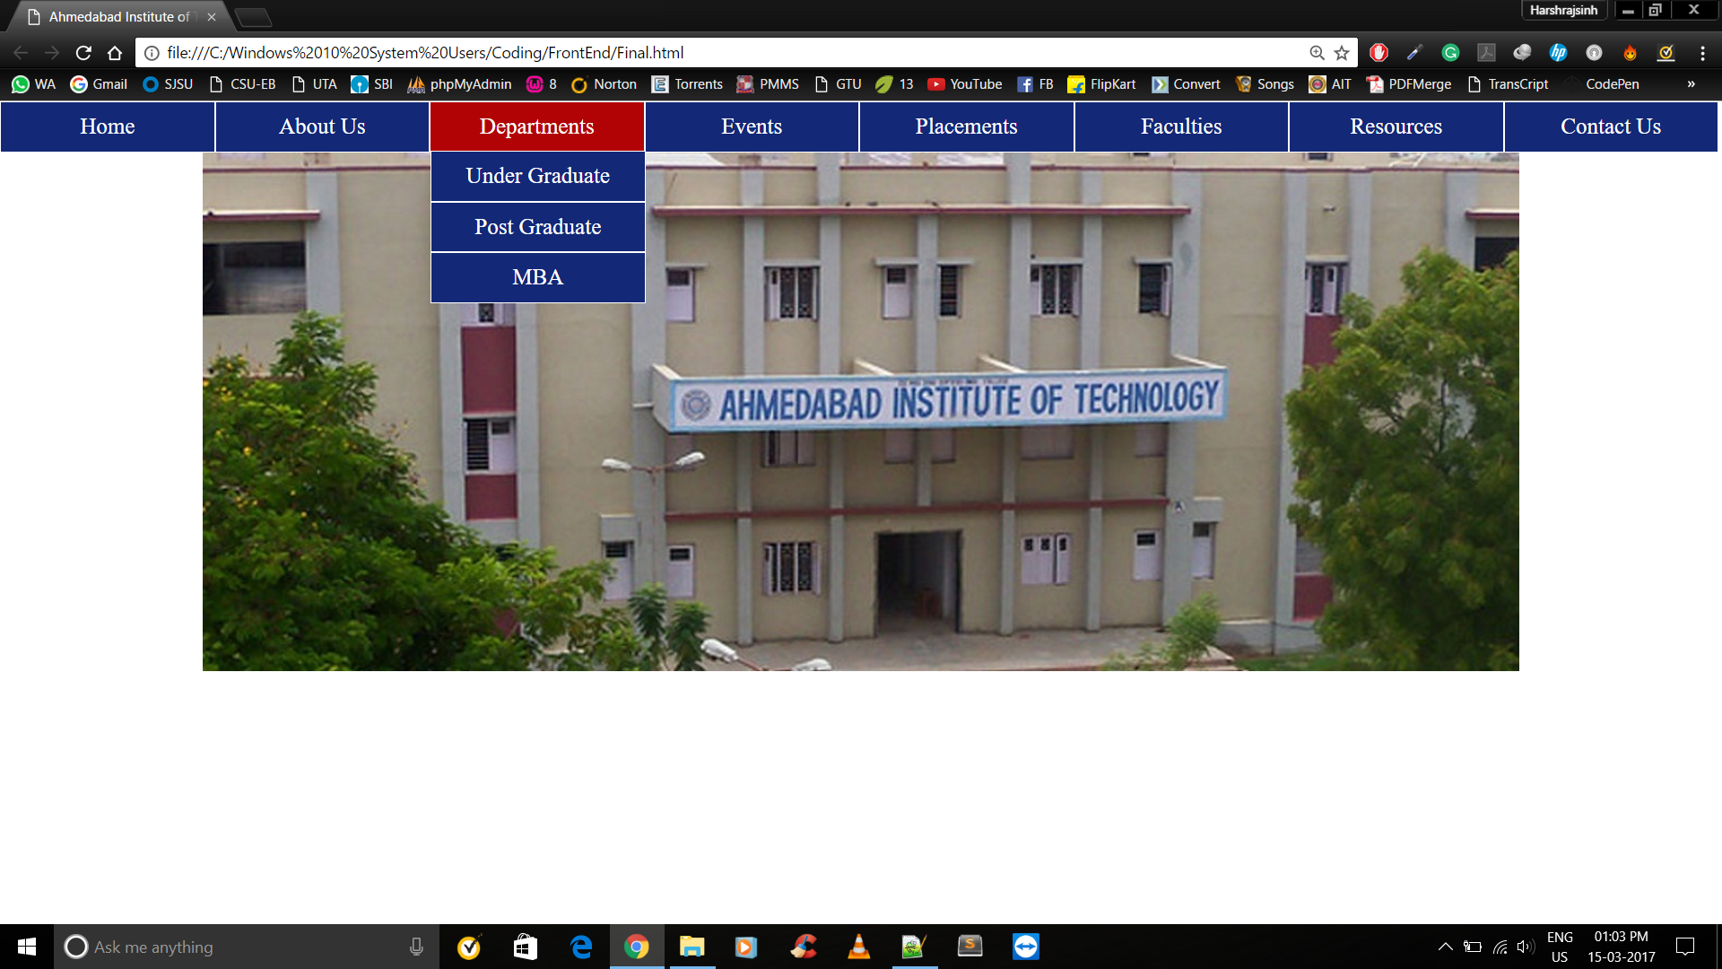
Snapshots of gui
Initial work

Slide 16
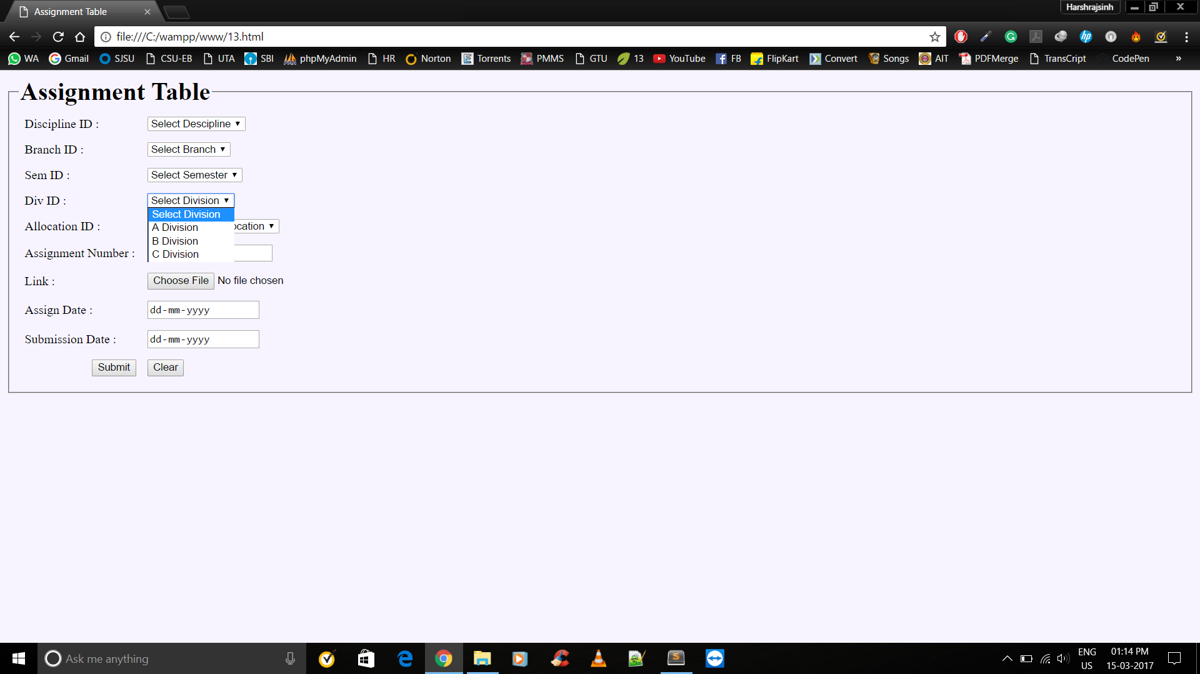
Assignment uploadation form

Slide 17
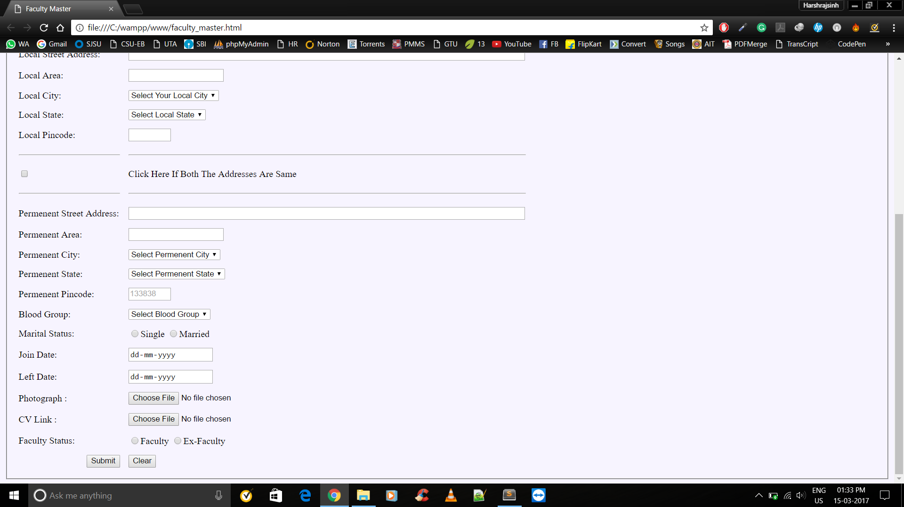
Different arranged forms : ex-faculity TABLE

Slide 18
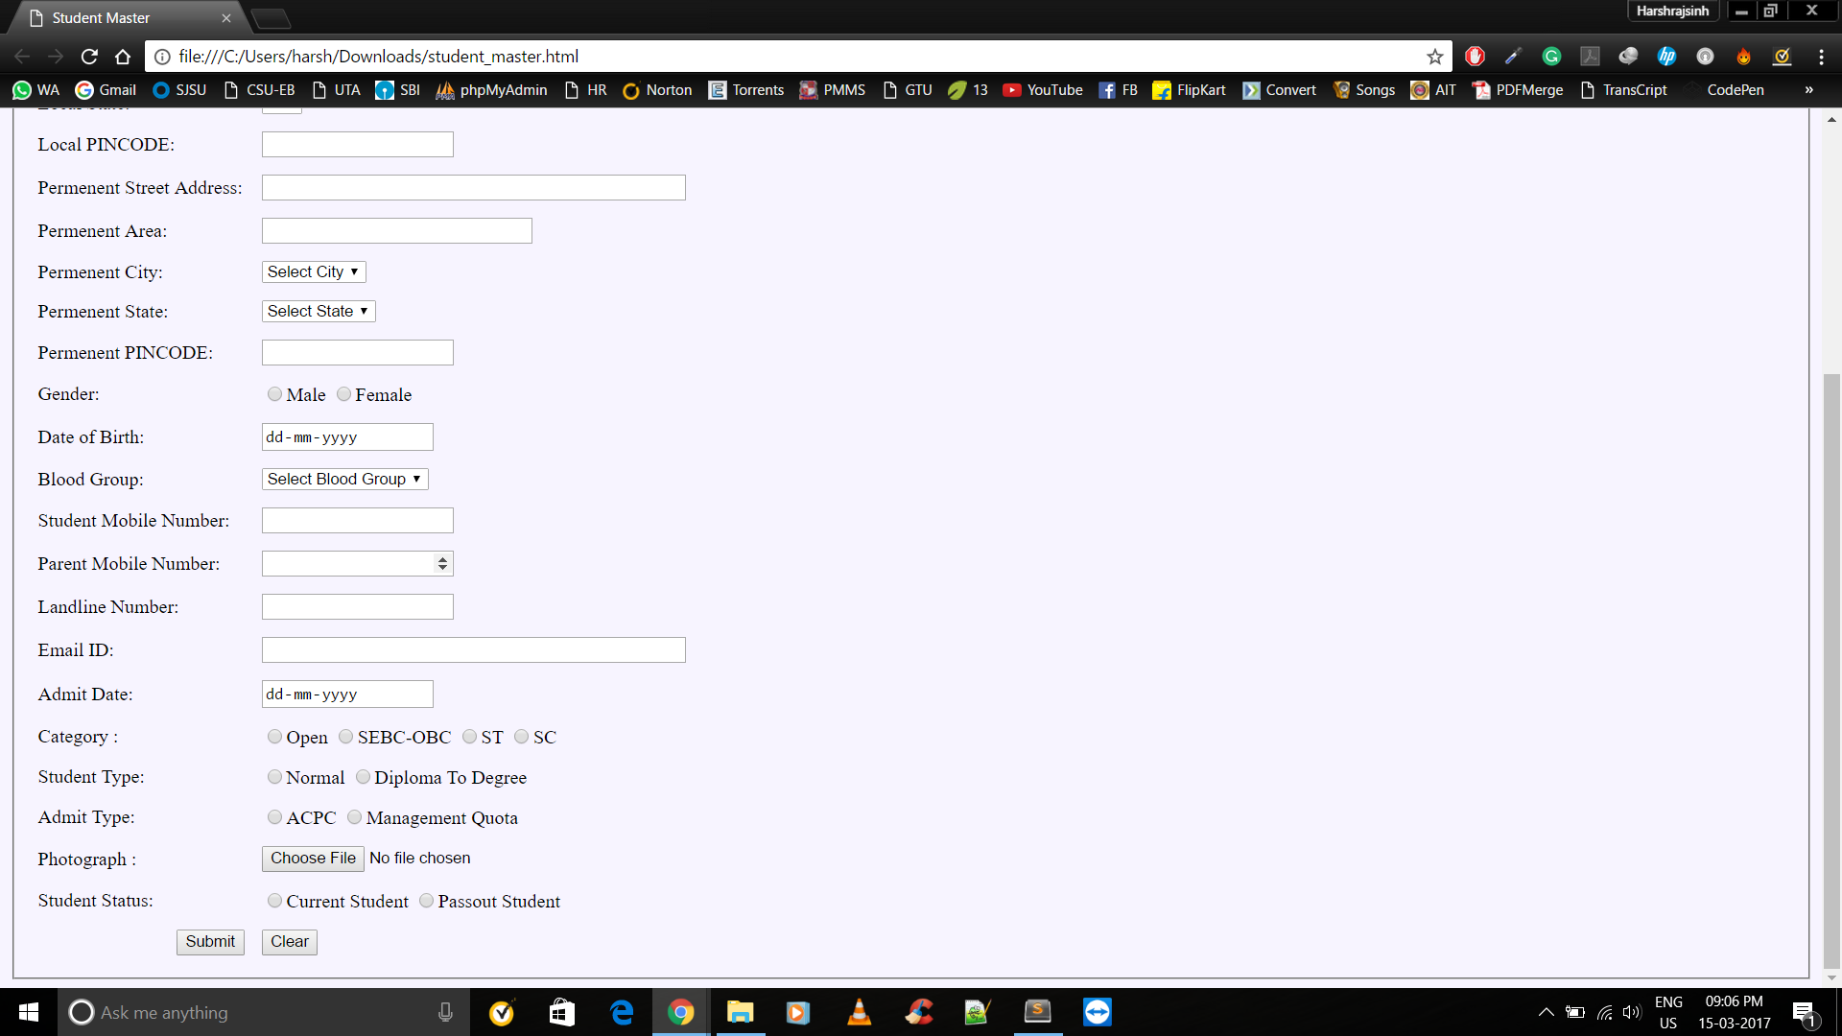
ex-student TABLE

Slide 19
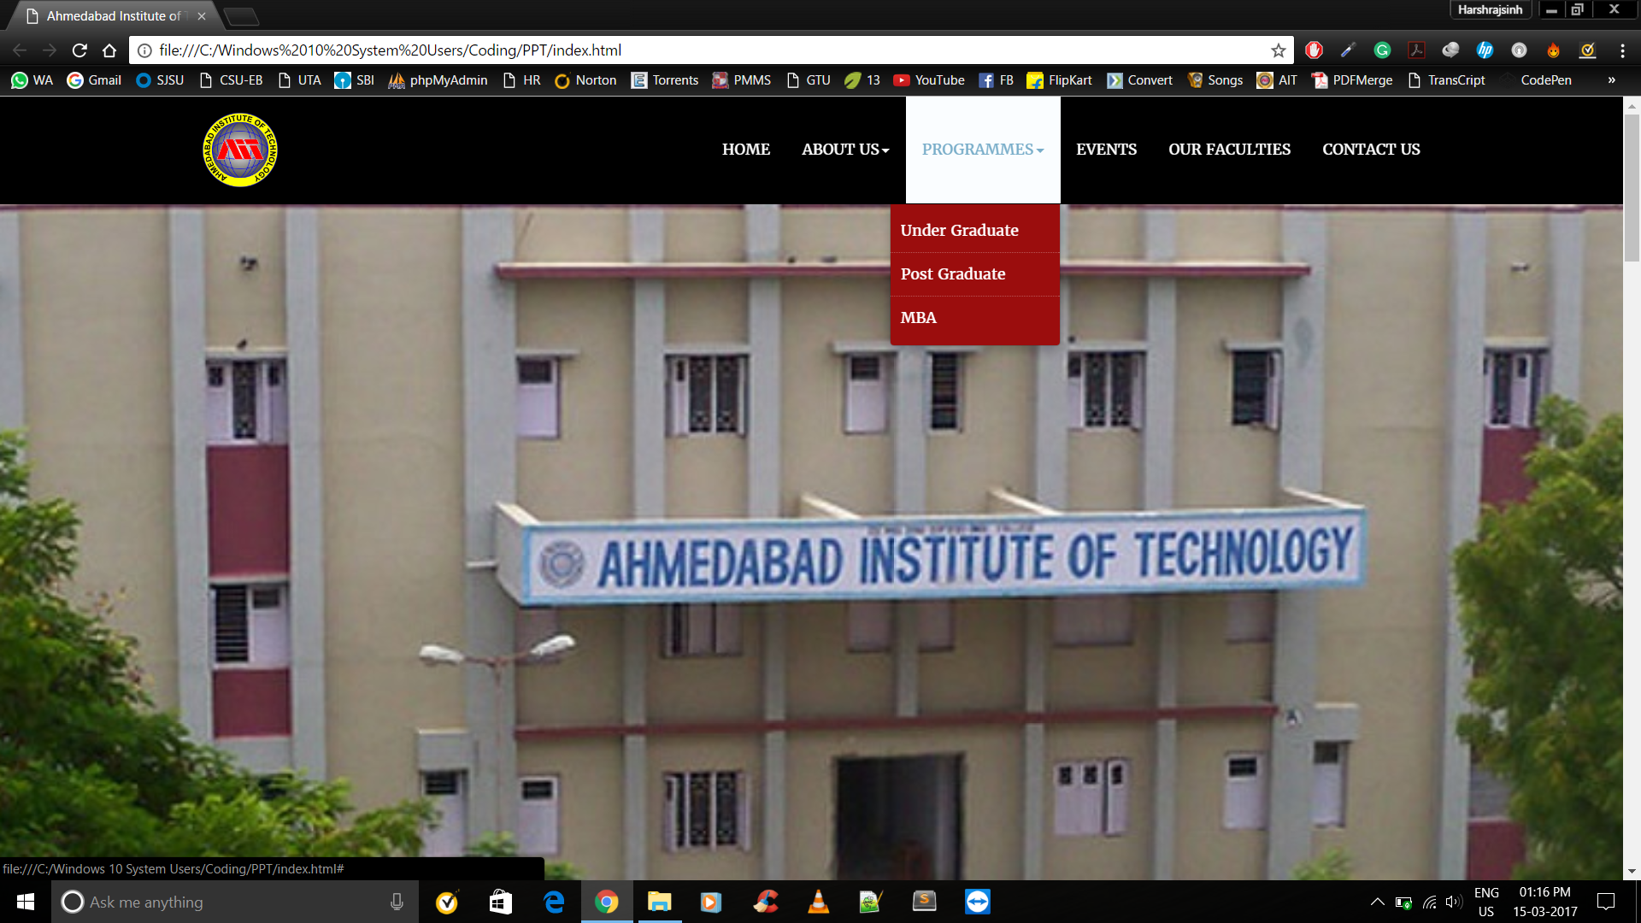
Current work

Slide 20
EXPECTED OUTCOMES
Core information available with reduced numbers of clicks.
Compatibility across bowsers.
Better co-ordination between all the four modules.
Minimal Paper work

Slide 21
ADVANTAGES
Explore possibilities of effective and positive relationship between connected modules.
Easy to take Attendance of students.
Helpful for Management and faculty and admin team.
Any authenticated user can get desired data.

Slide 22
LIMITATIONS
Good internet connectivity required.
User must be authenticated to use the data.
User must be familiar with English language and computer technology as well.

Slide 23
FUTURE WORK
Available Library and stationary Books Record
Pay Canteen Bill Through Online Wallet
Forums
Student Placement activity
Alumni records and job details
Meetup activity

Slide 24



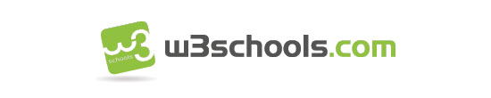
References

Slide 25


